Slide 1

“Everybody in this country should learn how to program a computer….. because it teaches you how to think.”
-Steve Jobs

Slide 2


Intro to programming
Frc & labview

Slide 3
Agenda
Why programming?
Is it hard?
Programming Languages?
Basic Concepts
FRC
LabVIEW

Slide 4
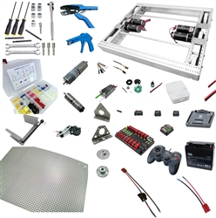
Why do we need to learn programming?

Slide 5
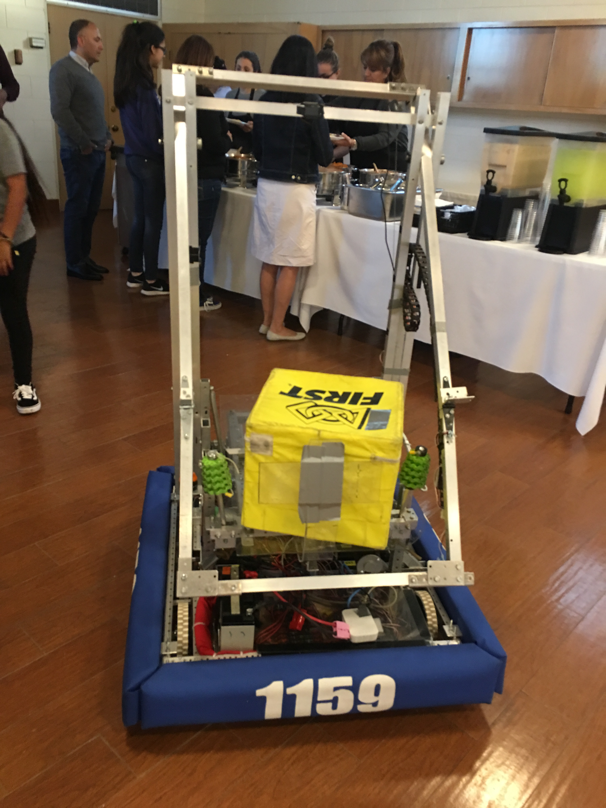
Why do we need to learn programming?

Slide 6
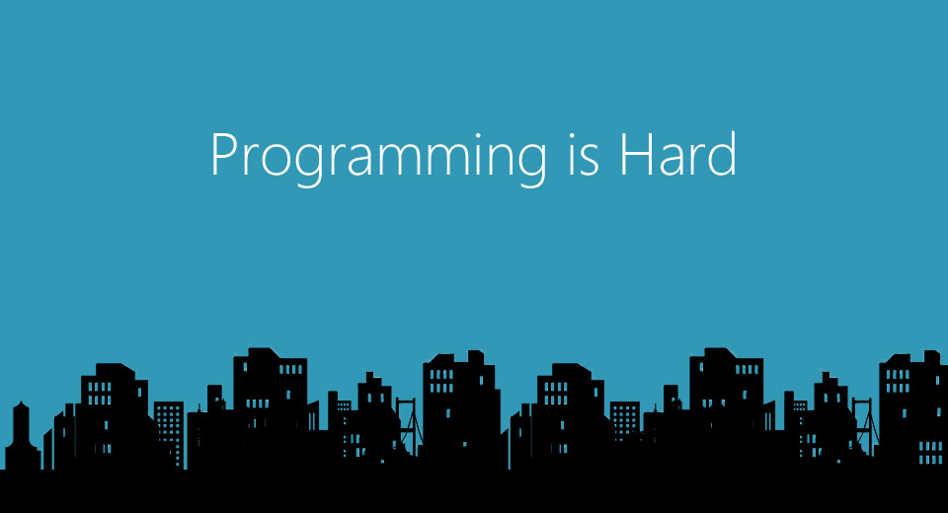

Slide 7
Is programming Hard?
Myth – Programming uses tons of math!
Myth – Programmer sits in front of computer all day!
Majority of seem to think “Programming is 100% logic – breaking your head all day” - it is hard to be passionate about!

Slide 8
Is programming Hard?
We already do incredible things: walk, talk, etc.
Same thing with programming, take baby steps
Break things down
Code one thing and check
Keep adding and check
Finish and check

Slide 9
Analogy: Learning to ride bicycle
Difficulties for beginners:
Learning to balance & go forward together
Difficulties for experienced folks:
Nothing specific.

Slide 10
Solution for beginners
Training wheels
Helmet
Makes learning enjoyable and safe!
Similar difficulties are there while learning to program in a computer.

Slide 11
Learning to program: Difficulties for beginners
Syntax errors
struggle for hours to fix syntax errors
Loose confidence
Frustrating experience
Run away & never come back if possible!
2. Logic errors
Not a serious issue.

Slide 12
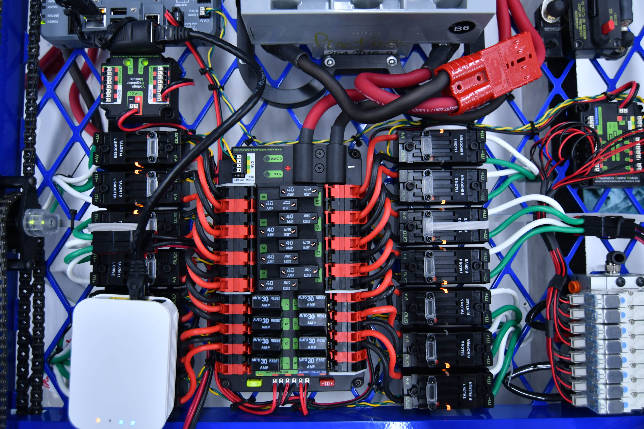
Is programming Hard?

Slide 13
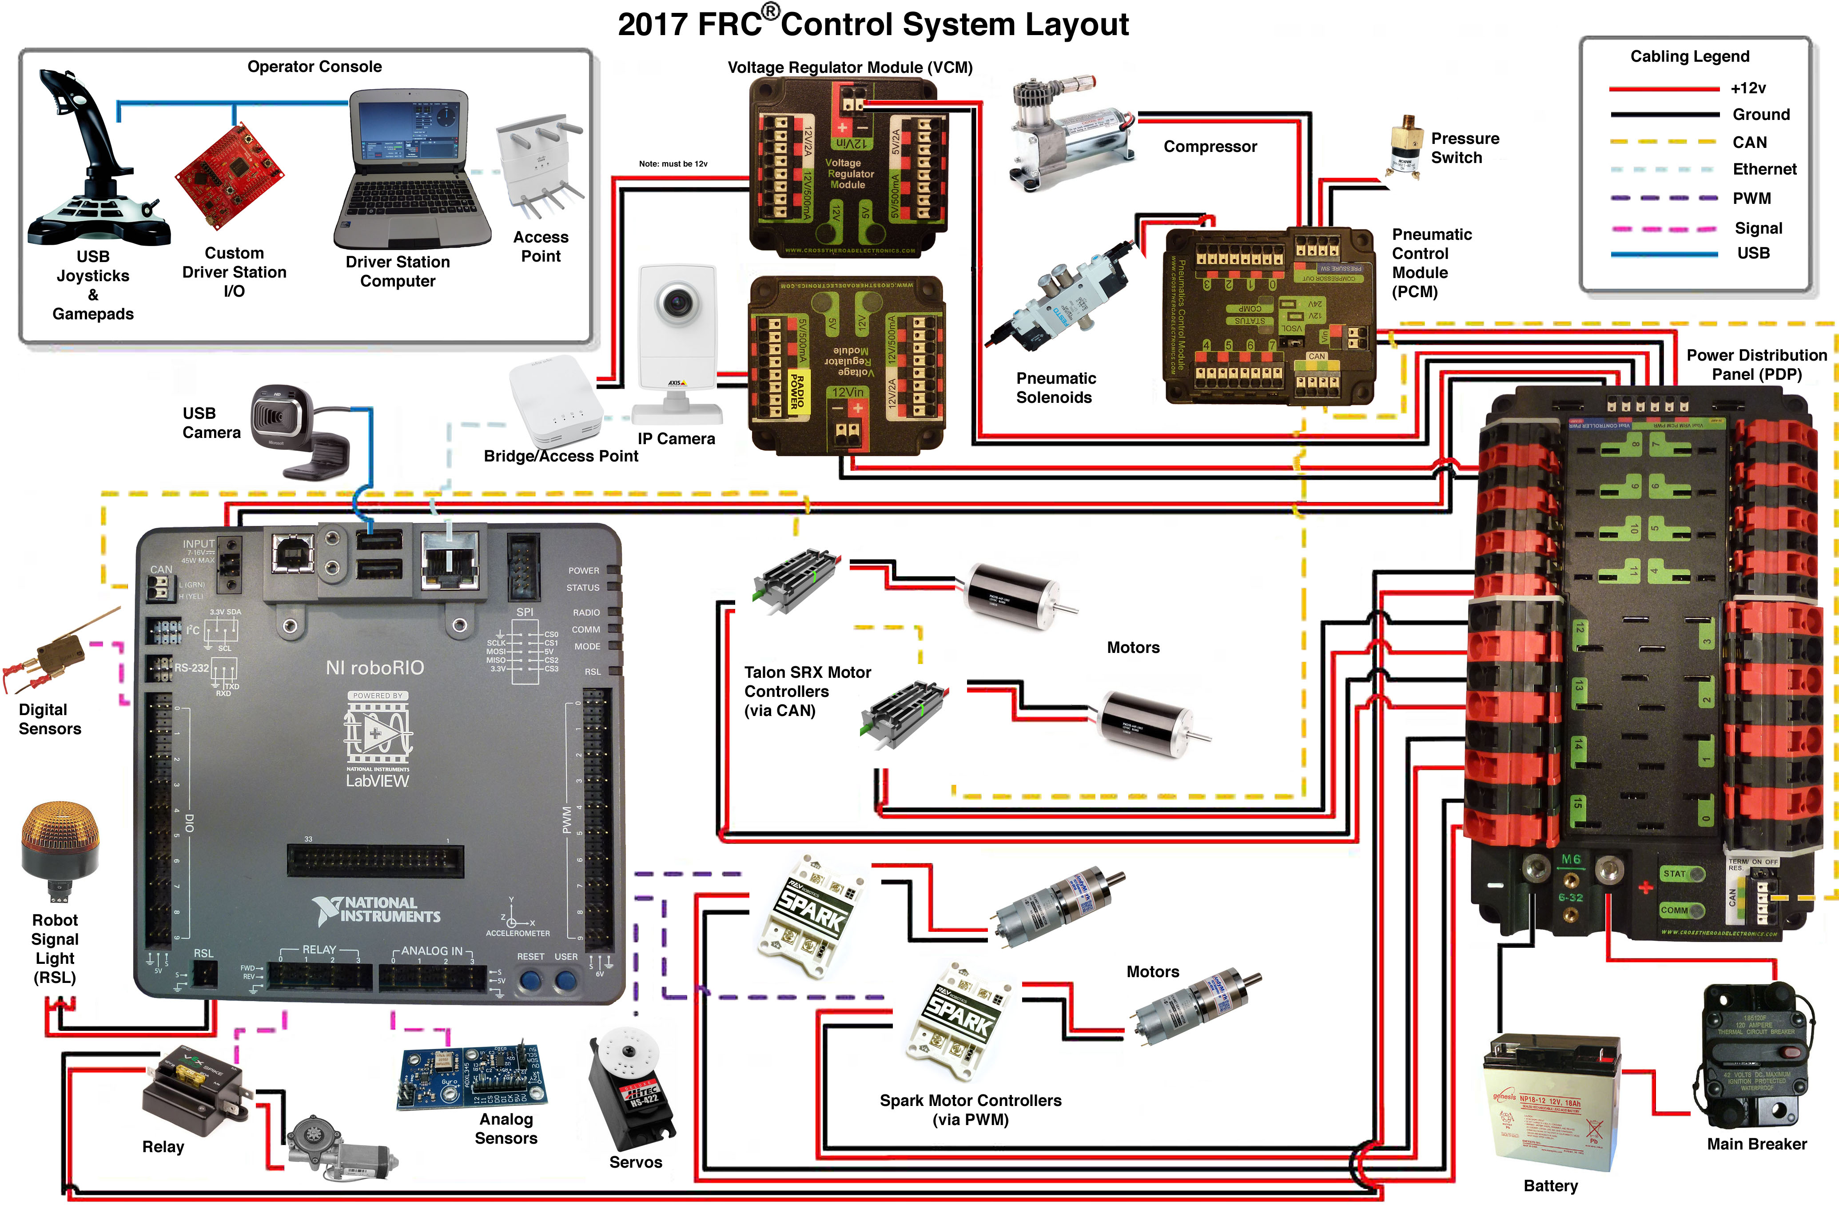
Is programming Hard?
Is programming Hard?

Slide 14
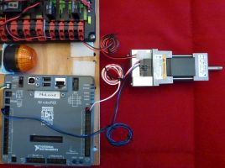
Do one thing a at time

Slide 15
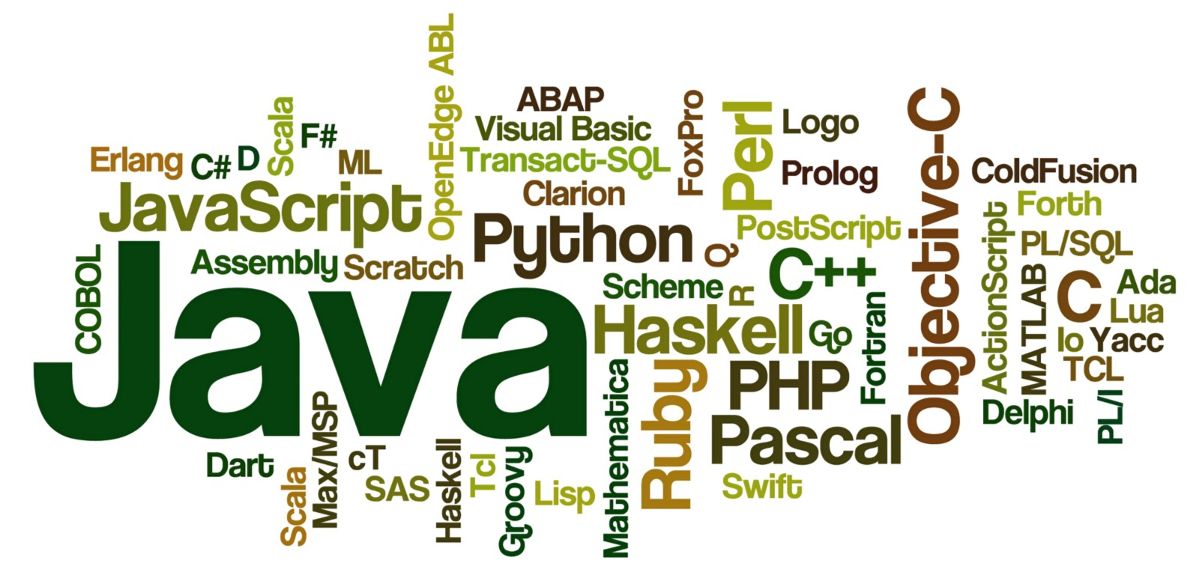

programming Languages

Slide 16
programming Languages
Text based
Graphical

Slide 17
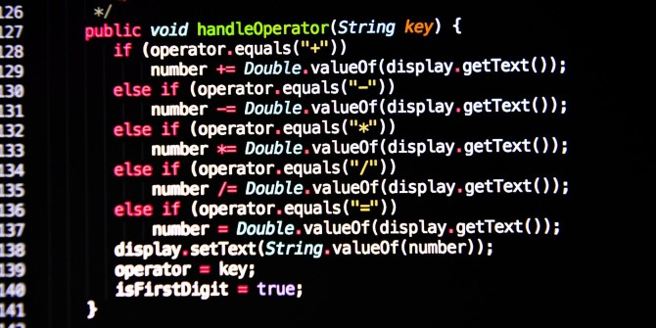
Text based

Slide 18
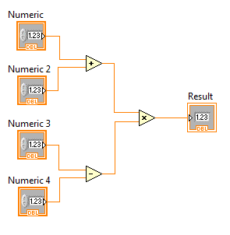
Graphical

Slide 19
FRC programming LANGUAGES
JAVA
C++
Python
LabVIEW

Slide 20
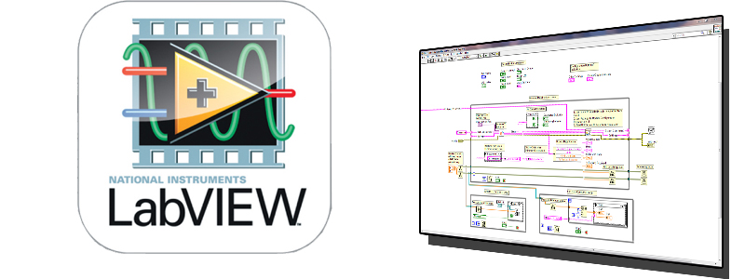
Ramona rampage

Slide 21
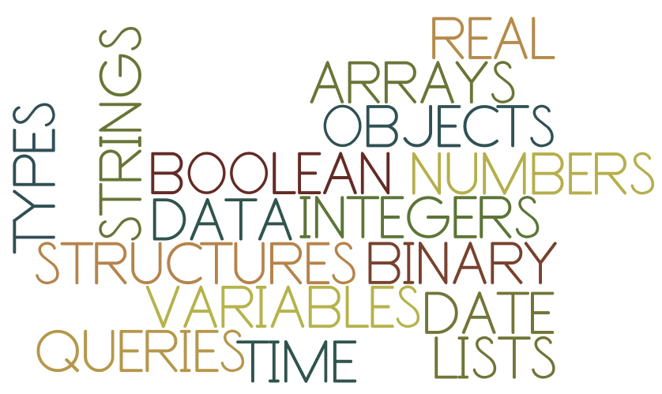
Learn the basic Programming concepts

Slide 22
Learn the basic Programming concepts
Variables
Sequence
Selection
Repetition / Loops
Collection / Arrays
Interrupts / events

Slide 23
Programming Concepts based on every day activities

Slide 24
A few examples
Recipe to make favorite food
Assembly instructions for a toy
Getting ready in the morning to go to school
What is common about these activities?
Sequence

Slide 25
Programming concepts: Sequence structure
instruction 1;
instruction 2;
instruction 3;
…

Slide 26
A few more examples
Go to movie or study?
Eat salad or sandwich?
Go to job or go for higher studies?
What is the common thing here?
Selection or IF statement

Slide 27
Selection structure
IF condition is true THEN
do this;
ELSE
do that;
ENDIF

Slide 28
A few more examples
Eat chips from a packet
Go on a shopping spree with lot of cash!
Take an exam that has several questions
What is the common thing here?
Repetition / Loops

Slide 29
Repetition structure
WHILE (more items to process)
process the next item;
ENDWHILE
FOR month = 1 to 12
do monthly processing
ENDFOR

Slide 30
Programming Concepts
Structures: Sequence, Selection & Repetition
Foundation for Programming
Every complex program is only a combination of these structures.

Slide 31
More things we do…
Use a box to move lots of things from one room to another
Carry a pack of candies to class on your birthday!
What is the common thing here?
Collection / Arrays

Slide 32
Arrays
enable us to store data of similar type together.
enables us to handle varying size data.
Lines of code do not increase with more data!
FOR each item in array add item to total
ENDFOR

Slide 33
Even more things we do…
Get phone call when you are driving a car
Friend knocks on the door when you are watching a movie
What is the common thing here?
Interrupts / events

Slide 34
Event driven programming
Suspend current processing to process the event, or process it in parallel.
“Regular” processing flow & separate processing routine for each event.

Slide 35
10 ways to make learning to program enjoyable & efficient!

Slide 36
1. Take time to learn!
Each person may learn at different pace.
Each person has a different learning style.
Learning C/C++/Java directly is NOT recommended. What is the hurry?
If everything looks cryptic, you are going too fast!

Slide 37
2. Utilize examples
Instead of writing all the code from scratch, it is good to look at a few examples.
Also, majority of the learners prefer to look at examples instead of reading a manual.

Slide 38
3. Use a good STARTING Programming language

Slide 39
4. Plan before you code
You can be “slow and steady” or “race and burn”
It is common for experienced designers to do “race and burn” before reverting back to “slow and steady” ☺
Make a practice of writing high level pseudo code before coding – unfortunately, this is not insisted in most programming courses!

Slide 40
5. Learn with a friend
Learning in a group setting is preferred, if not, try to learn with a friend.
Discuss ideas and help each other when you get stuck.
Enables you to work on a team assignment
Self-paced learning alone is not for every one.
It requires lot of self-discipline & it is not much fun!

Slide 41
6. Mimic an interesting game/feature
It is easier to focus on implementation when functionality is clearly understand.
It is easy to “relate to”.

Slide 42
7. Have a time-discipline
I encourage you to fix the issues on your own, but do not spend >30 minutes on any one issue. Ask for help!
If not, your frustration level will increase & confidence will go down.

Slide 43
8. Implement a useful app/game
It increases your confidence level.
You can be proud of your work.

Slide 44
9. Use video tutorials
https://youtu.be/a02RWpKbAOo
https://www.youtube.com/channel/UC0QI19cxIozPeIRXYRgv6Ig
www.khanacademy.org/cs
…

Slide 45
10. Participate in programming competitions

Slide 46
programming FOR FRC

Slide 47
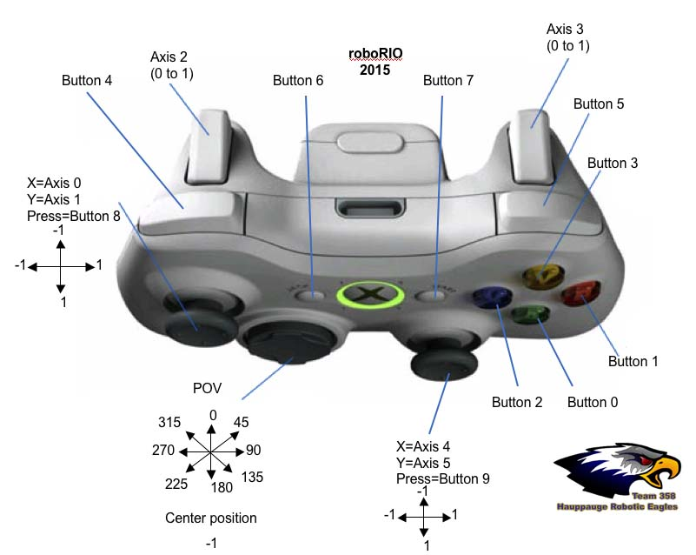
programming FOR FRC

Slide 48
programming FOR FRC

Slide 49
programming FOR FRC

Slide 50
programming FOR FRC

Slide 51
programming FOR FRC

Slide 52
programming FOR FRC

Slide 53
programming FOR FRC

Slide 54
programming FOR FRC

Slide 55
programming FOR FRC

Slide 56
programming FOR FRC

Slide 57
LabVIEW FOR FRC

Slide 58
What is labview?
Graphical Programming Language
Goes with the flow
Dataflow programming
Easy to learn
Powerful debugging tools

Slide 59
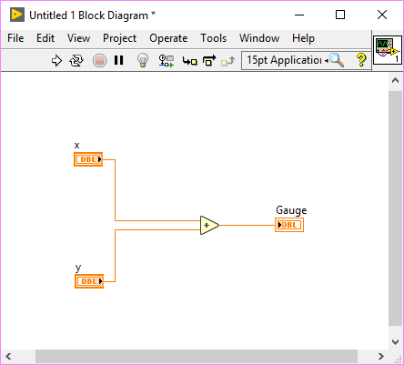
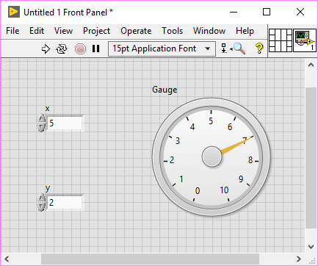
Labview programs are called vi’S

Slide 60
FRONT PANEL
User interface
Controls = Input
Indicators = Output

Slide 61
Block diagram
“Code”
Data travels in wires
from the controls
thru functions
to the indicators
Order of execution controlled by data flow

Slide 62
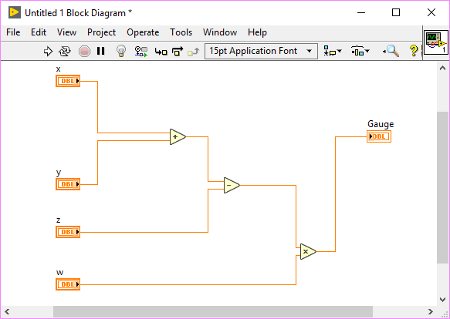
Data flow
Order of execution controlled by data flow

Slide 63
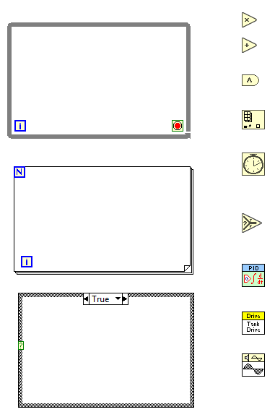
Labview nodes
Math functions
Boolean logic
Arrays
Timing
Logic
PID Control (Proportional, Integral, Derivative feedback loop Gain)
FRC WPILib
Signal Processing

Slide 64
Labview nodes
Math functions
Boolean logic
Arrays
Timing
Logic
PID Control (Proportional, Integral, Derivative feedback loop Gain)
FRC WPILib
Signal Processing

Slide 65
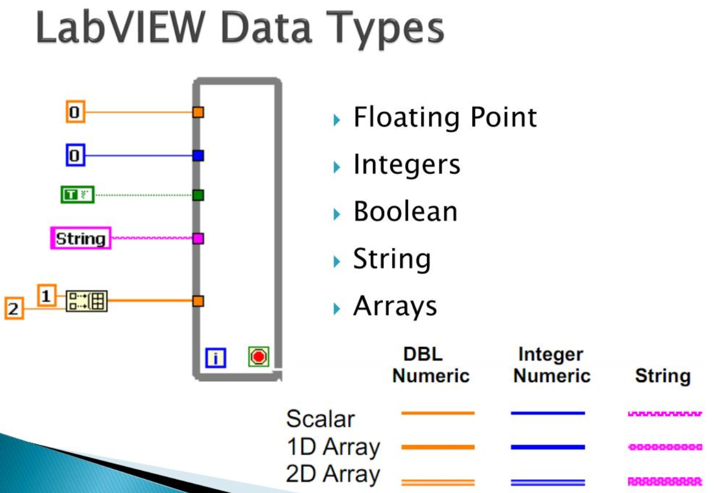

Slide 66
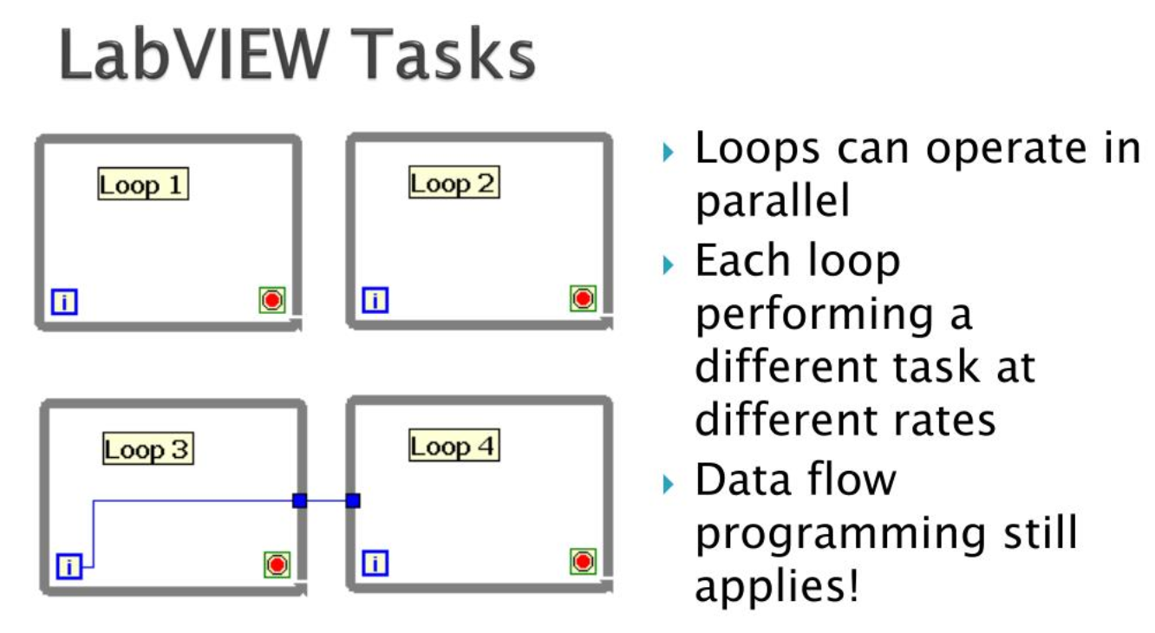

Slide 67
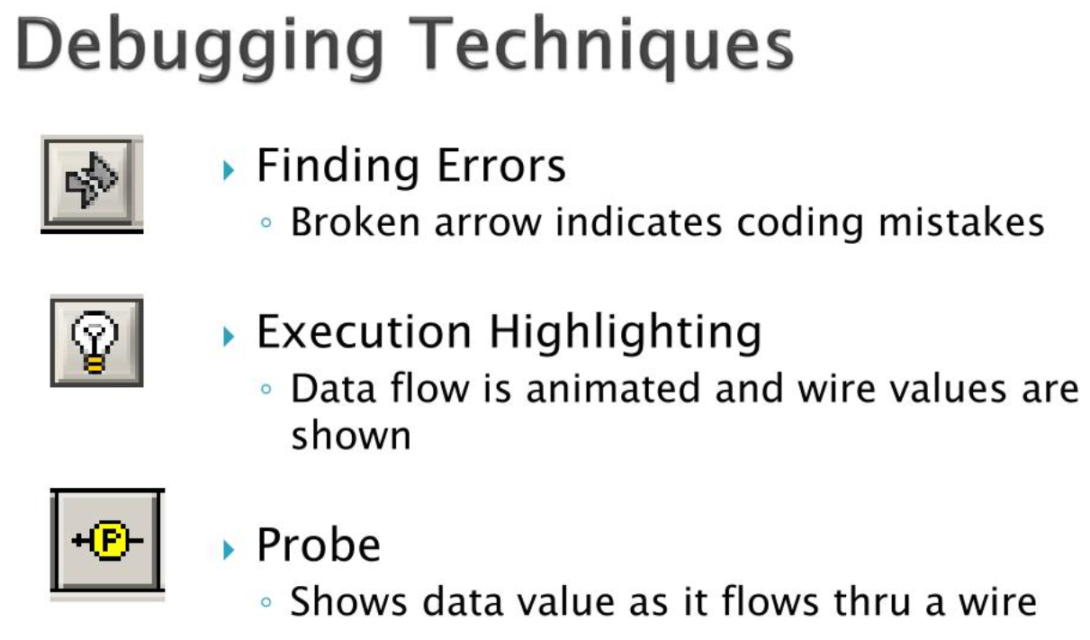

Slide 68
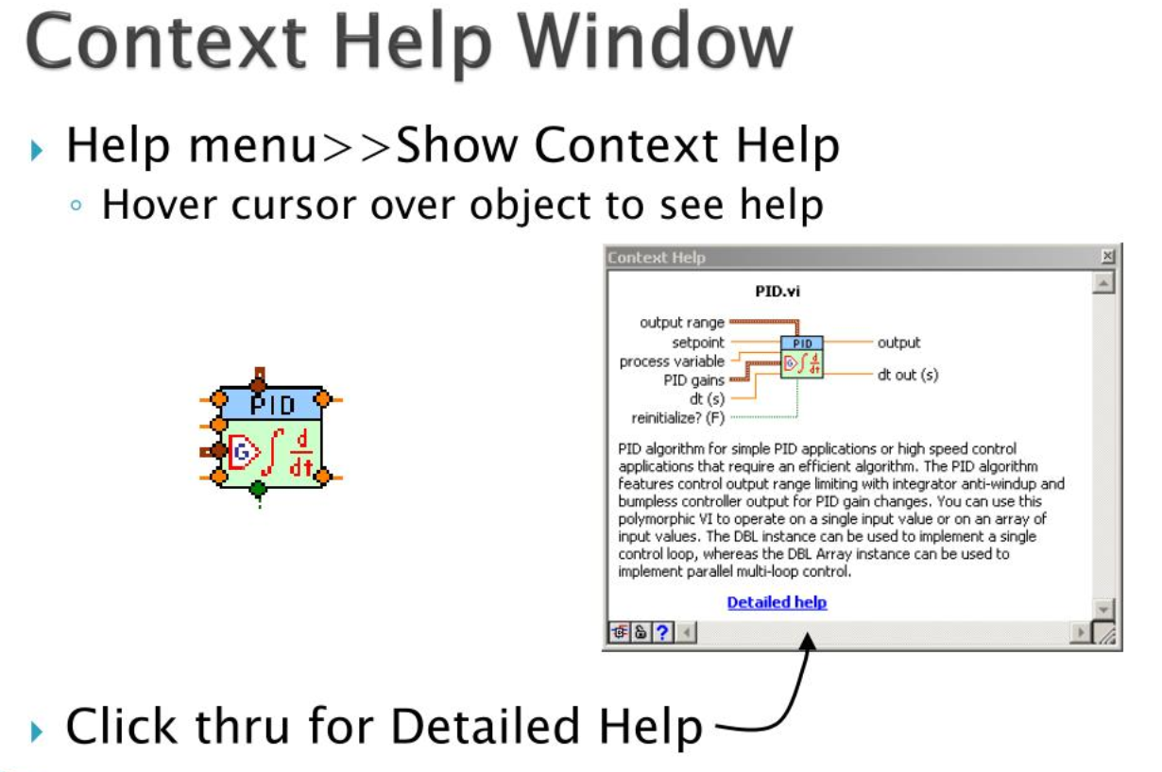

Slide 69
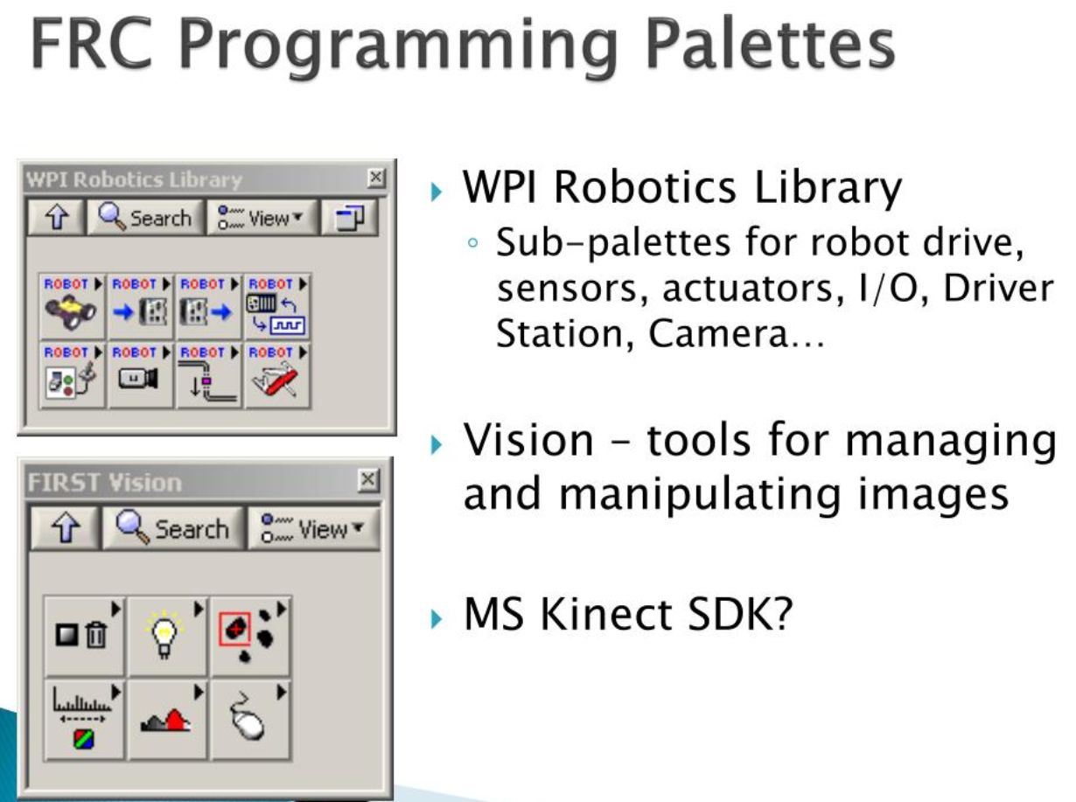

Slide 70
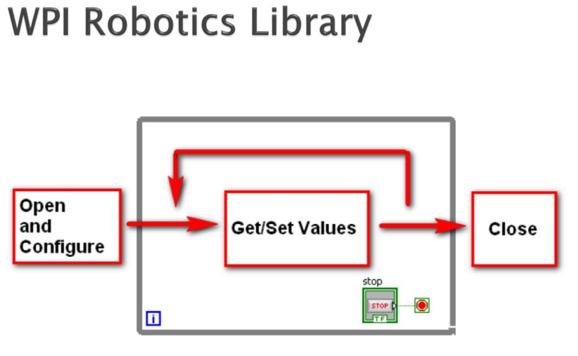

Slide 71
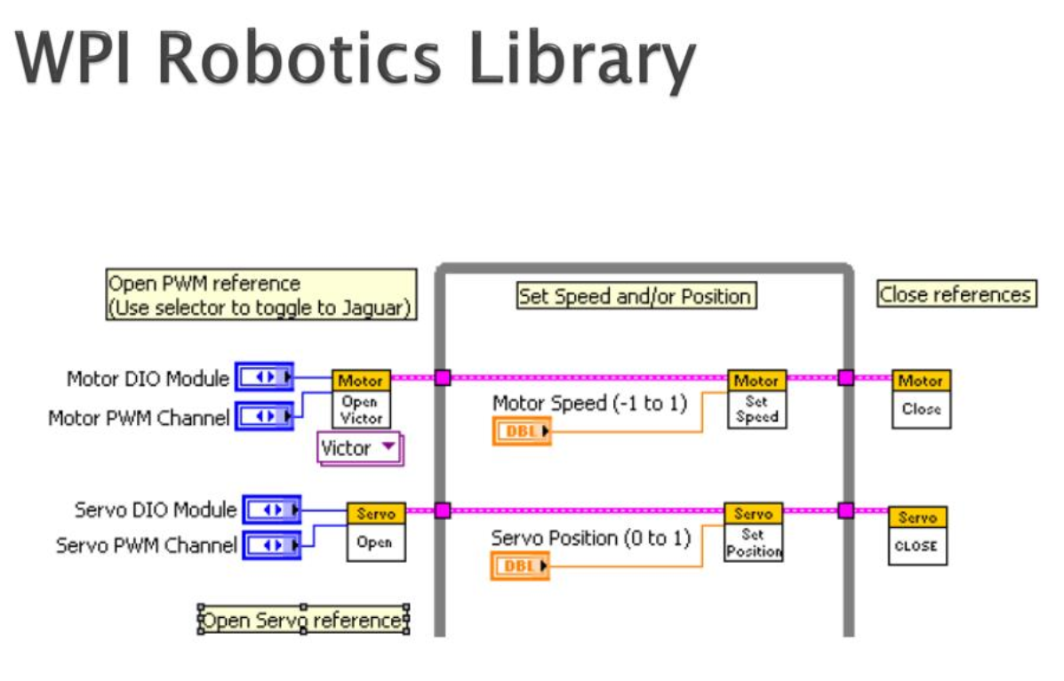

Slide 72
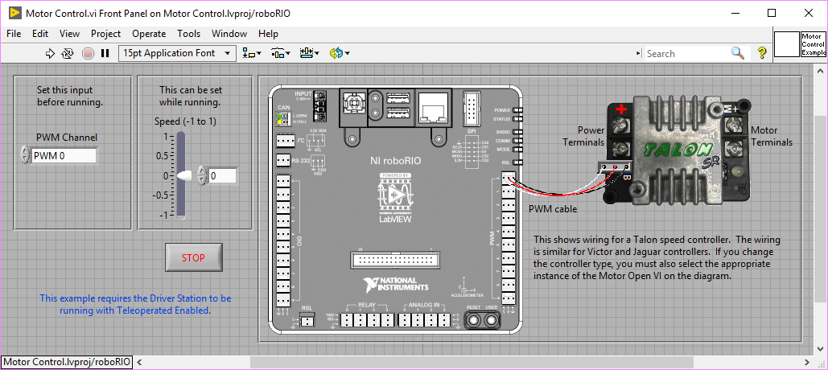
FRC SPECIFIC EXAMPLES

Slide 73
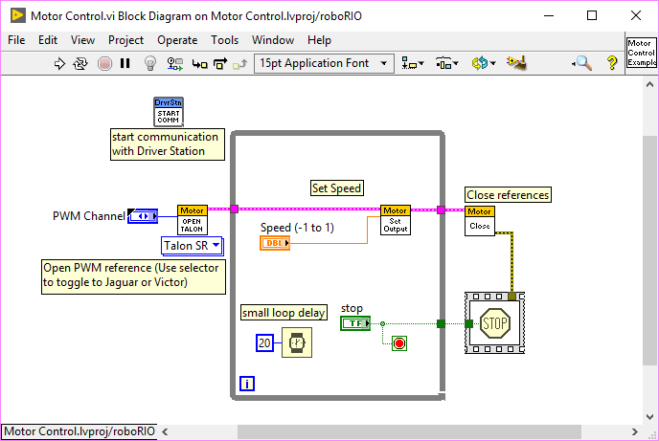
FRC SPECIFIC EXAMPLES

Slide 74
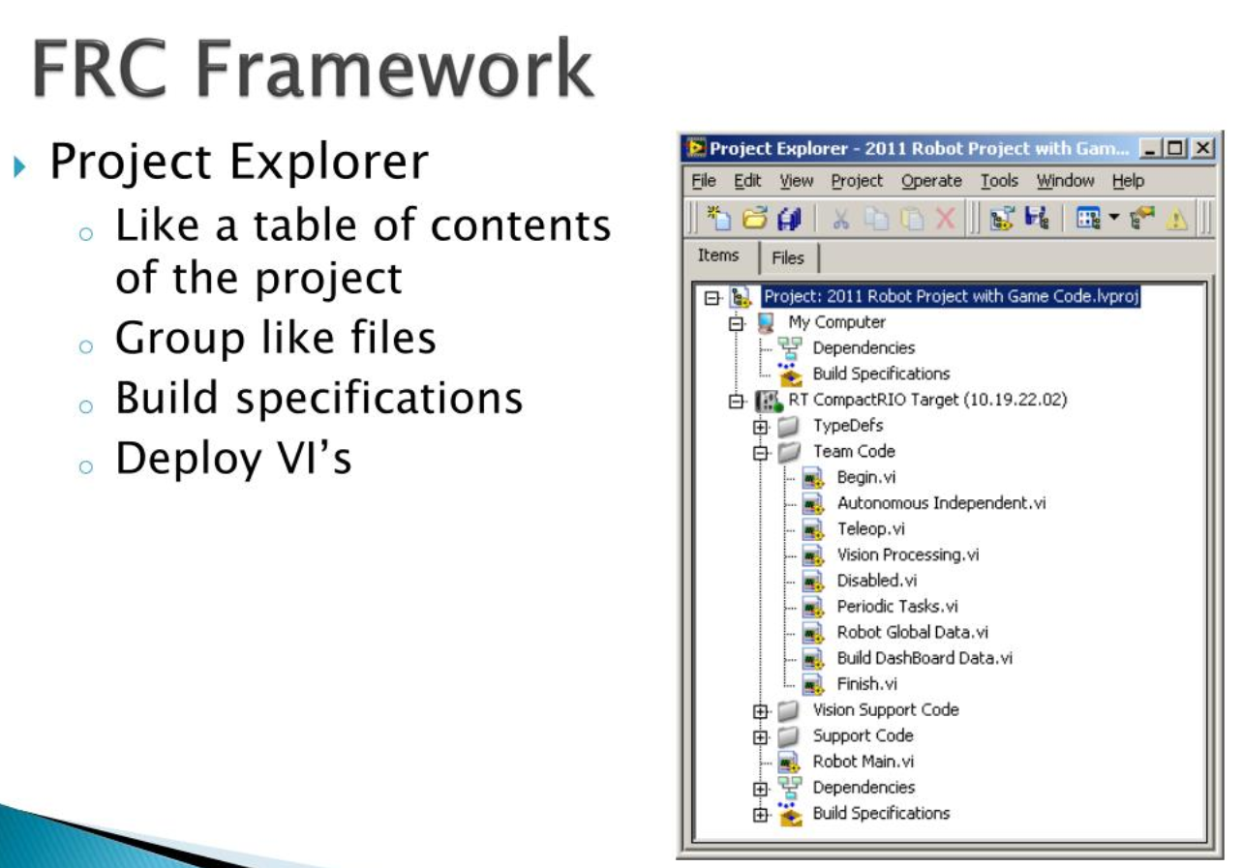

Slide 75
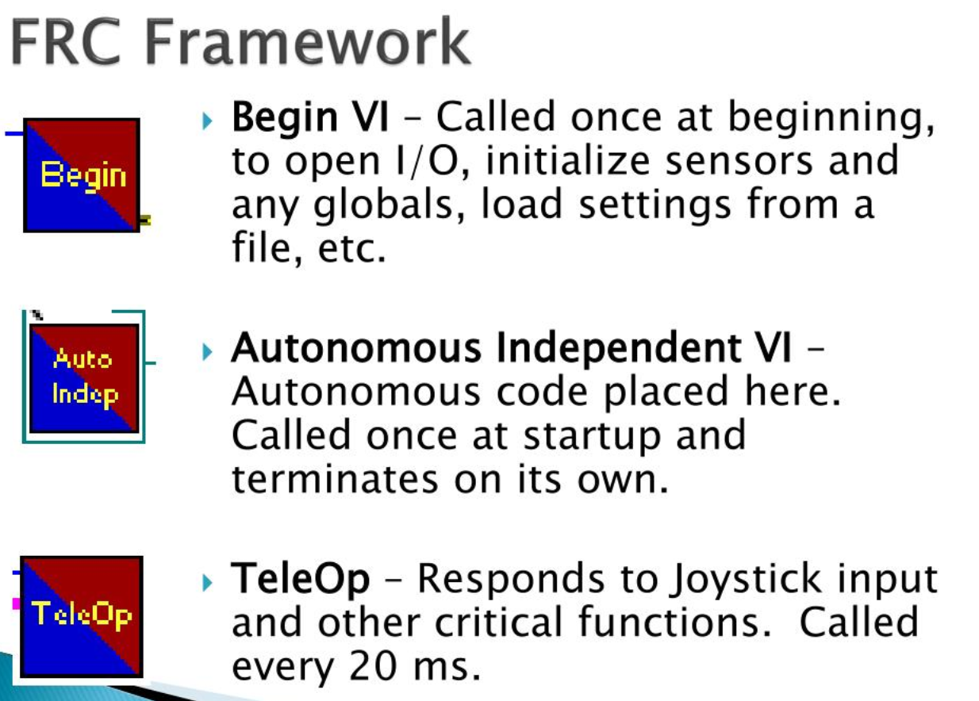

Slide 76
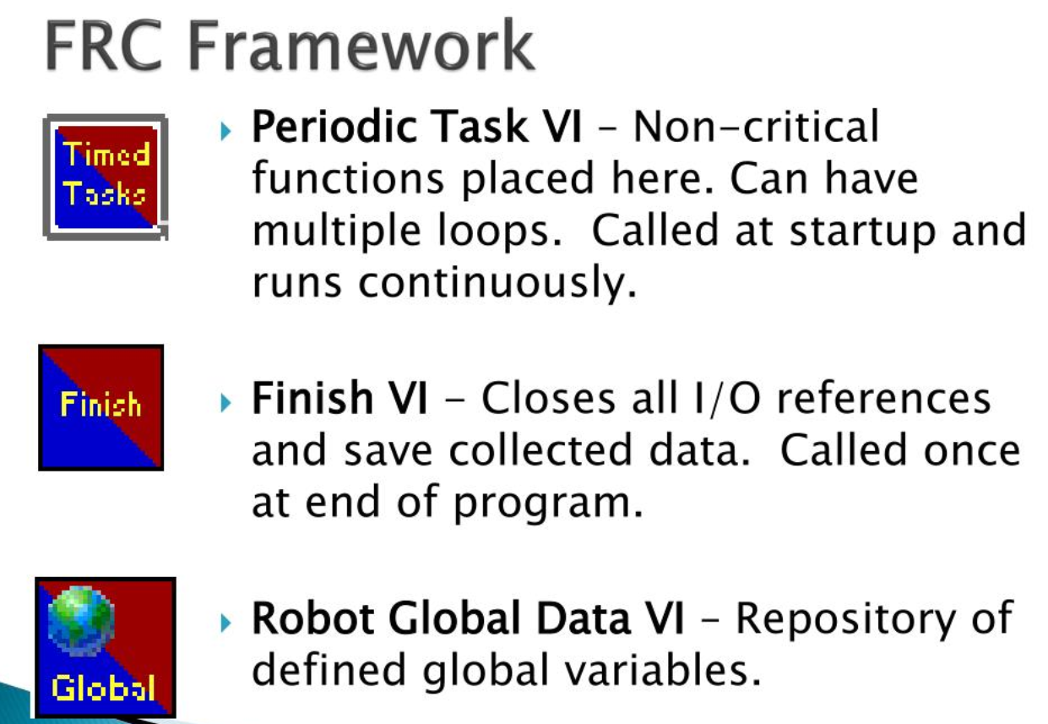

Slide 77
resources
http://www.ni.com/first
https://www.firstinspires.org/resource-library/frc
http://www.chiefdelphi.com
Technical>Programming>LabVIEW

Slide 78
LABVIEW tutorials
Getting Started with LabVIEW
FRC LabVIEW Tutorial
Fundamentals of LabVIEW for FRC - Episode 1
Fundamentals of LabVIEW for FRC: Episode 2 - Vision and Control
Fundamentals of LabVIEW for FRC: Episode 3 - Command and Control Architecture
FUNdamentals of LabVIEW for FRC: Episode 4 - Source Code Control and Tips & Tricks

Slide 79


Slide 80


